Slide 1
Run PowerShell with Azure deployment scripts
Leo Visser

Slide 2


Leo Visser
Cloud Consultant @ OGD ICT-diensten
Azure DevOps and Automation
Azure Infrastructure
Blog: autosysops.com
Socials: @AutoSysOps
Notes:
Intro: 2 min (2)

Slide 3
Agenda
Infrastructure as Code
What are deployment scripts
When to use deployment scripts
Authentication
Input and output
Troubleshooting
How I used them

Slide 4
Infrastructure as Code
Less errors - standardization
Less manual labor – automation
Better disaster recovery
Easy transfer

Slide 5
Infrastructure as Code
Arm or Bicep Templates
Template Specs
Azure DevOps Pipelines / GitHub Actions
Deployment Stacks

Slide 6

What are deployment scripts
Deployment
Resource
Resource

Slide 7

What are deployment scripts
Deployment
Resource
Resource
Script
Resource

Slide 8
Demo
Deploy Runbook
Notes:
Demo 1 2 min (9)

Slide 9
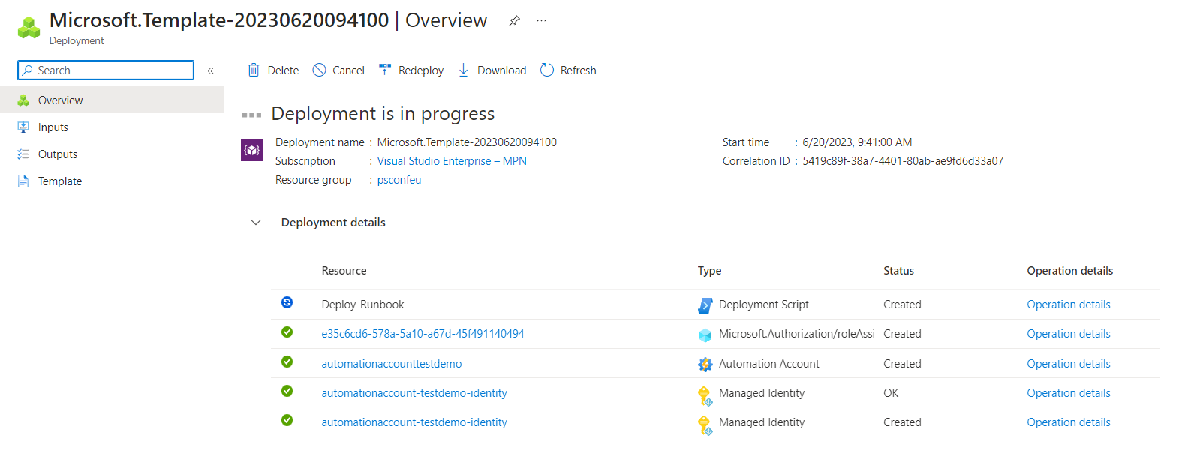

Slide 10
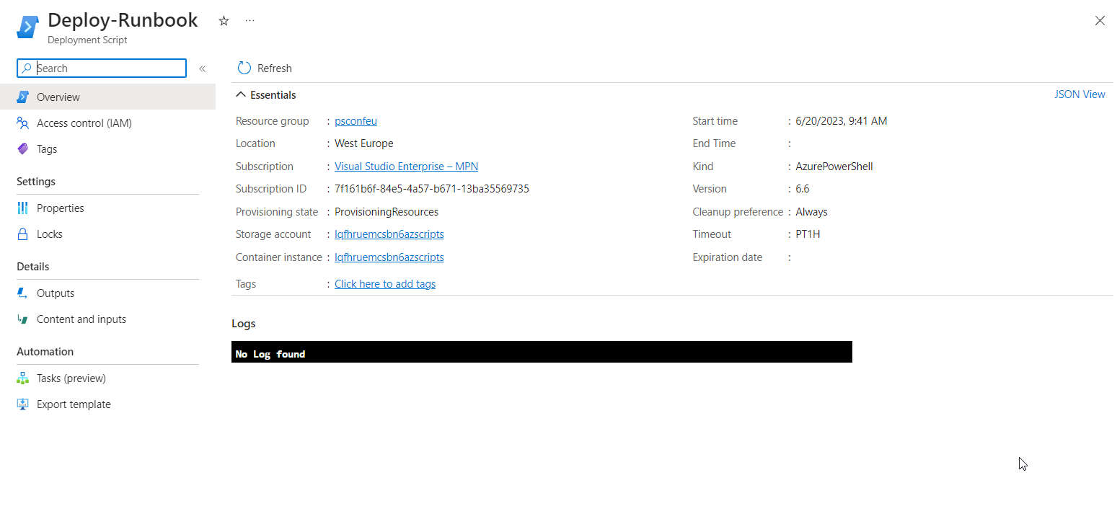

Slide 11
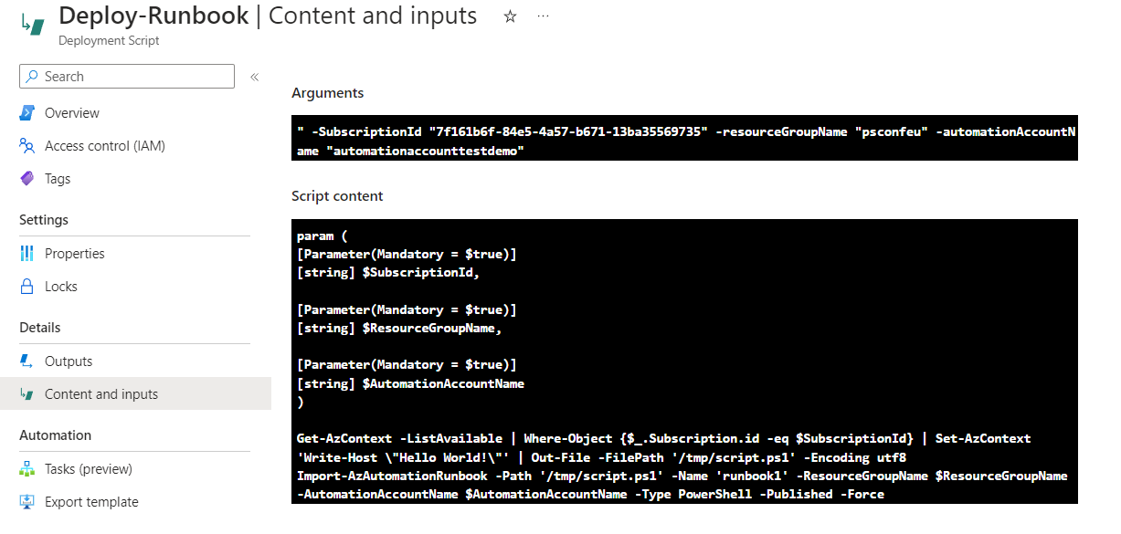

Slide 12
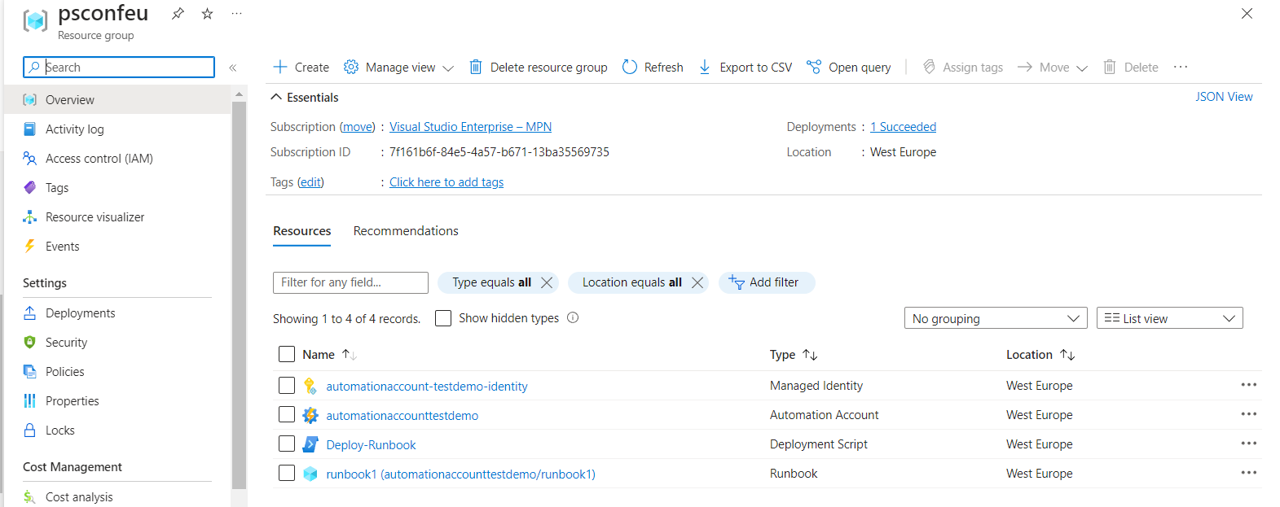

Slide 13
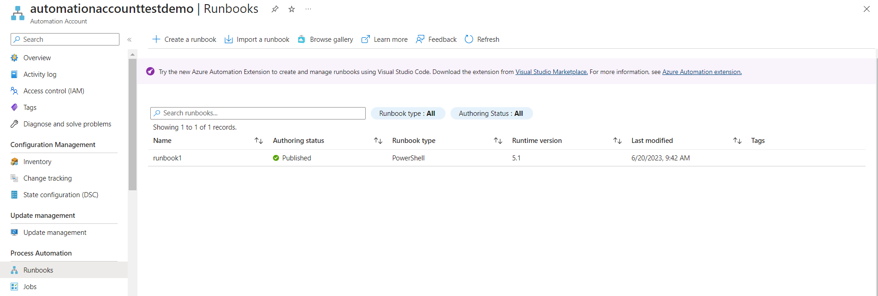

Slide 14
When to use deployment scripts
Needs to be one deployment template
Examples:
Adding delay
Calculating values
Running additional tasks

Slide 15
When to use deployment scripts
ARM and BICEP supported
Advantages:
Automatic cleanup
Identity options
Scripts in remote locations
AzPowerShell included

Slide 16
Demo
Look at script
Notes:
Demo 1 2 min (9)

Slide 17
Authentication
Managed Identities
User assigned
Create permissions beforehand

Slide 18
Demo
Look at authenication
Notes:
Demo 1 2 min (9)

Slide 19
Input and output
Input:
Defined as arguments in template
Multiple inputs supported
Output:
Defined as $DeploymentScriptOutputs object
Multiple outputs supported

Slide 20
Demo
Deploy Schedule
Notes:
Demo 1 2 min (9)

Slide 21
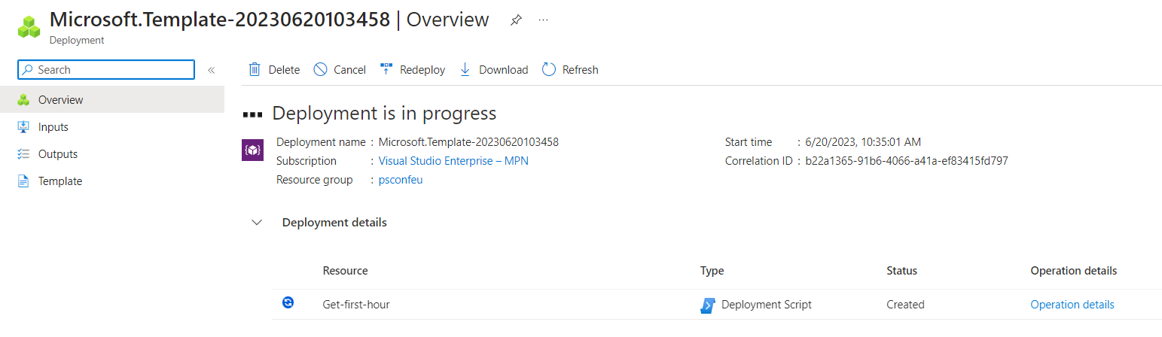

Slide 22
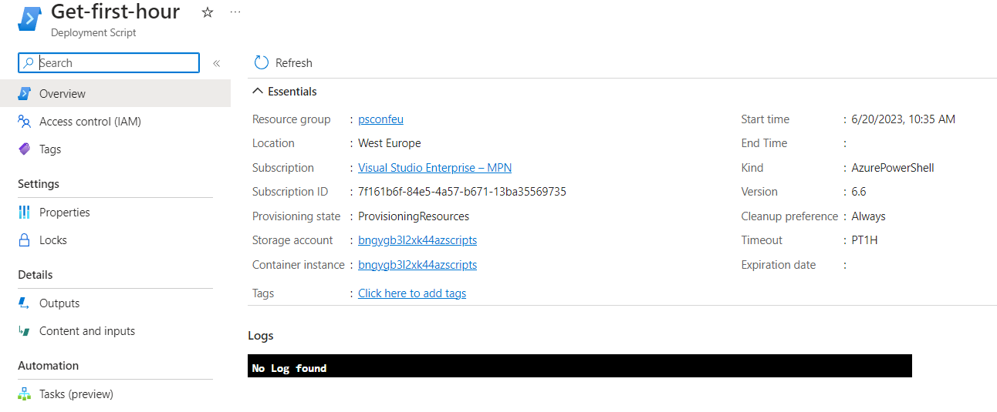

Slide 23
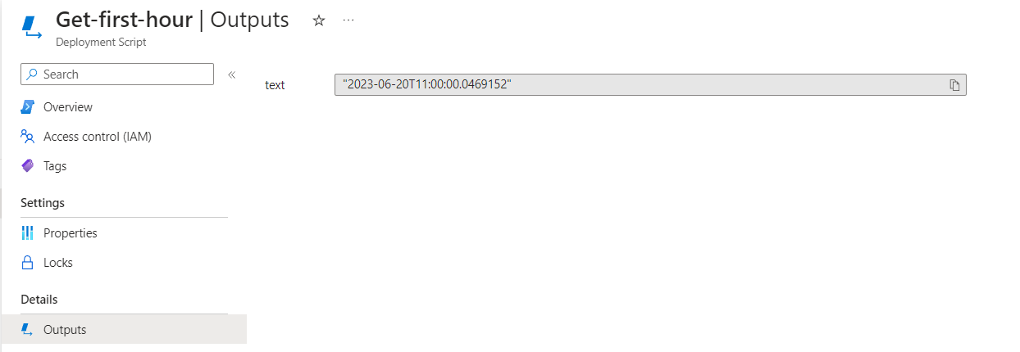

Slide 24
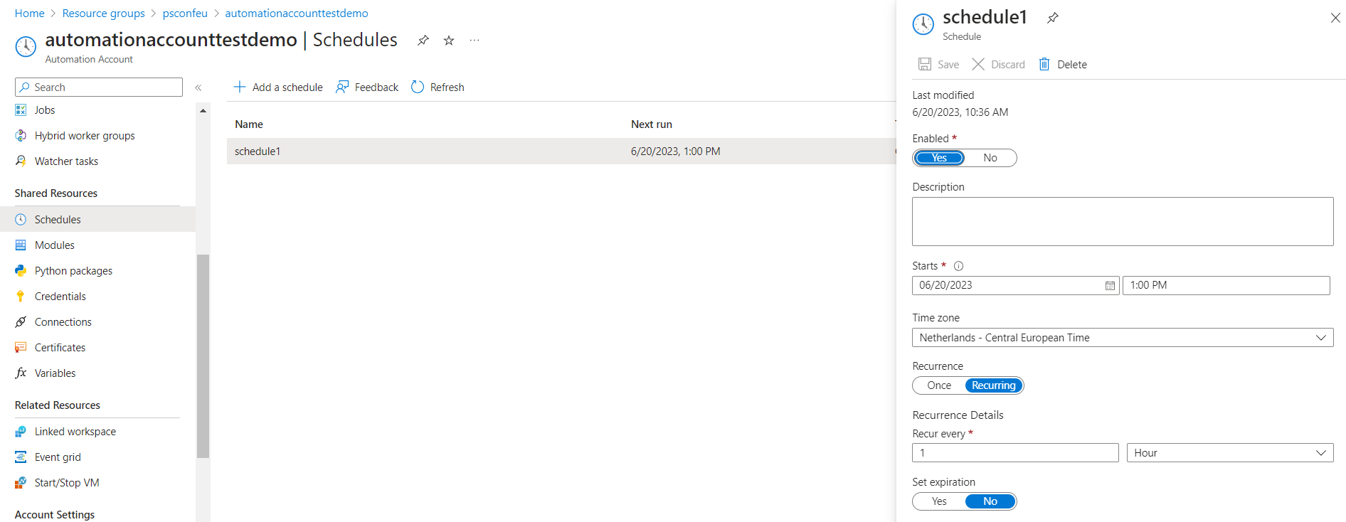

Slide 25
Troubleshooting
Scripts can fail
Error logging

Slide 26
Demo
Failed Script
Notes:
Demo 1 2 min (9)

Slide 27
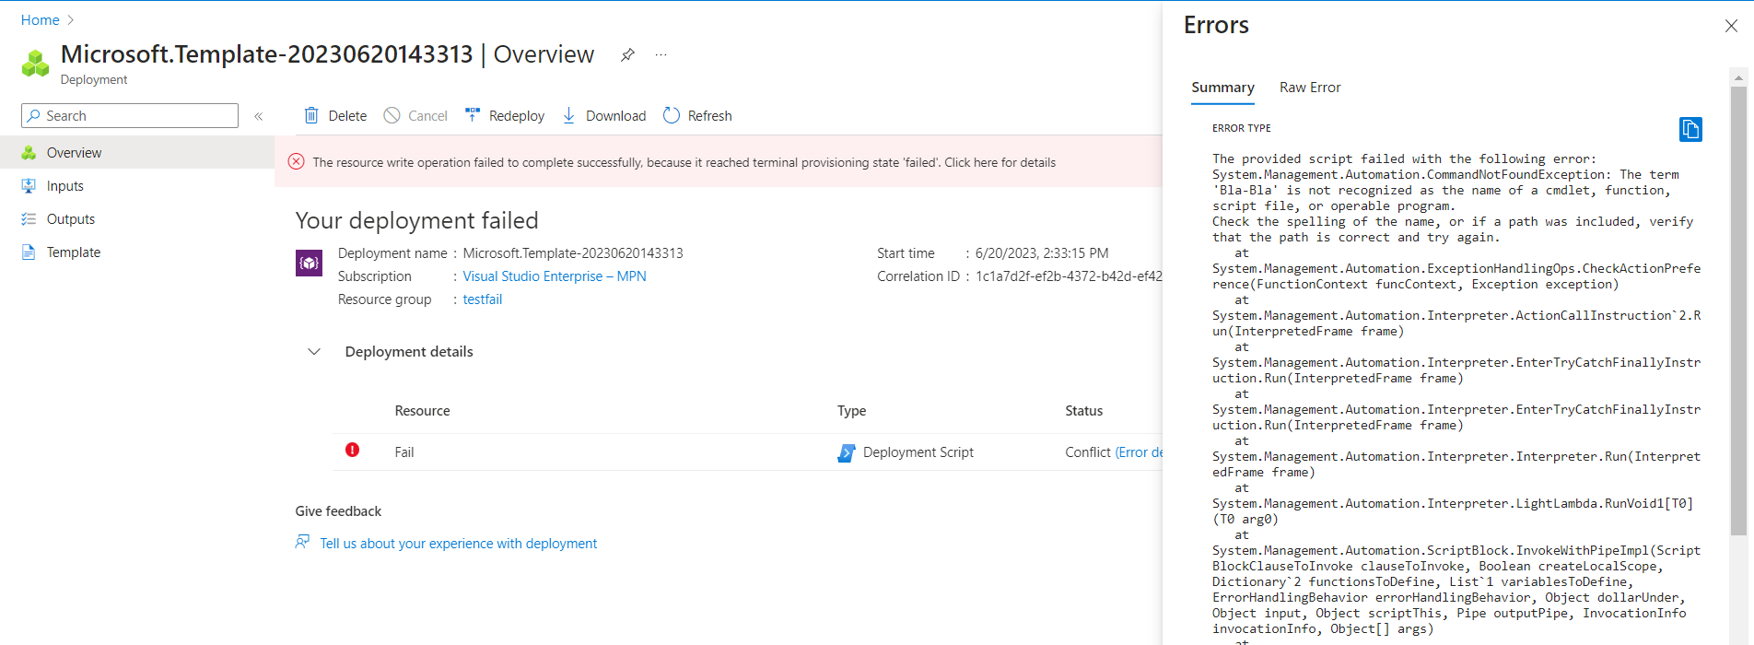

Slide 28
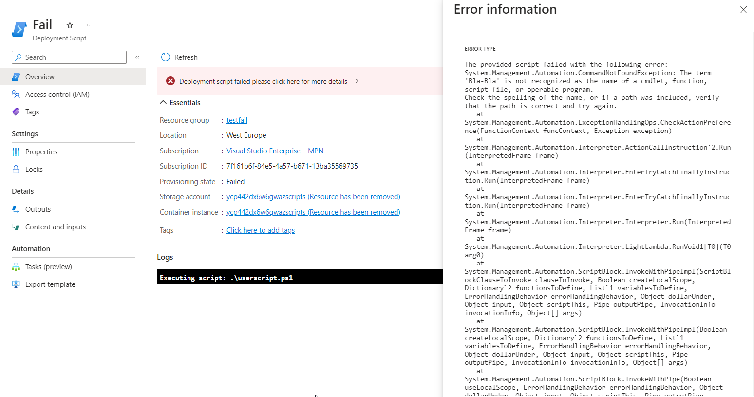

Slide 29
How I used them
Policy remediation scripts for complex tagging requirements
Automatically deploy a start/stop vm solution with custom scripts for update management

Slide 30
Questions?
Blog: autosysops.com
Socials: @AutoSysOps
Github: github.com/AutoSysOps
Notes:
outro 1 min (45)

